Slide 1
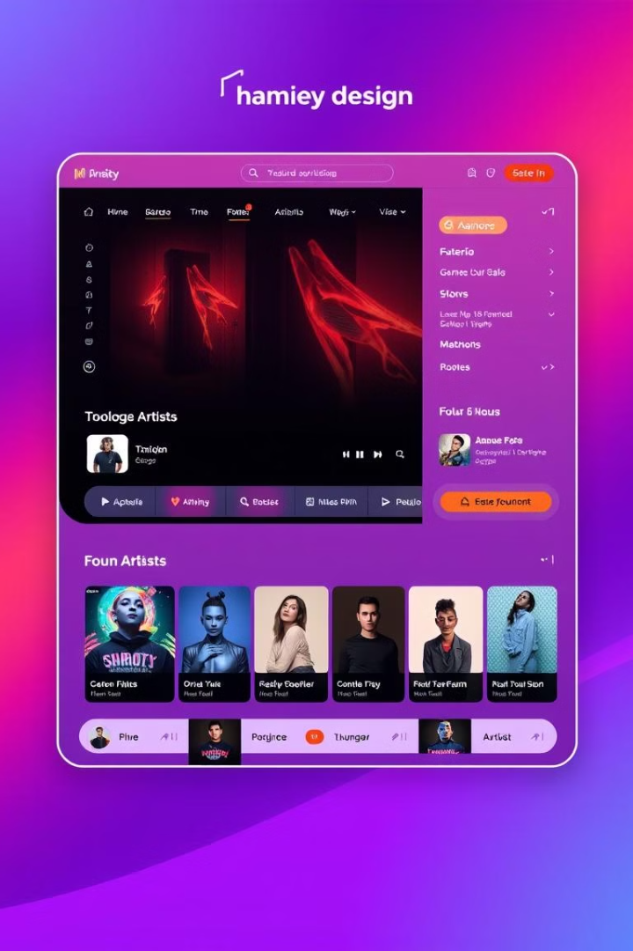
SonicFusion: Your Music, Your Way
Experience the ultimate music streaming with SonicFusion. Enjoy an extensive library of retro and modern tracks. Discover personalized playlists and an intuitive interface.
by Prachi Burde & Manjil Pillewan

Slide 2
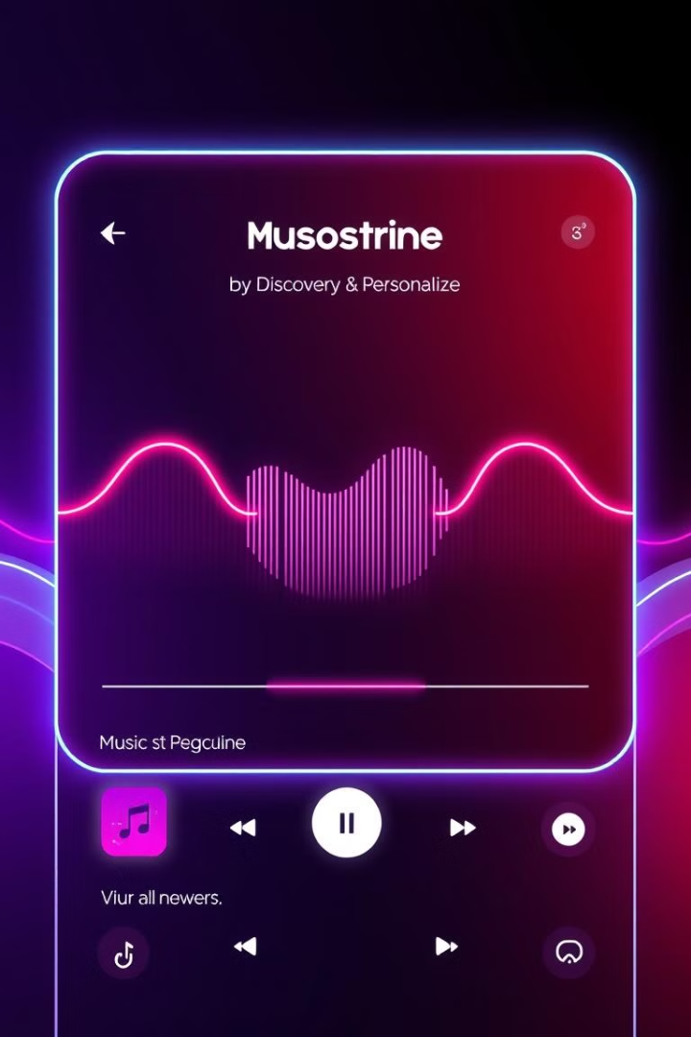



Revolutionizing Music Streaming
SonicFusion reimagines music discovery and playback. This efficient system replaces traditional storage. It offers real-time recommendations and secure access.
Discover
Find new music easily.
Stream
Enjoy uninterrupted playback.
Manage
Organize your playlists.

Slide 3
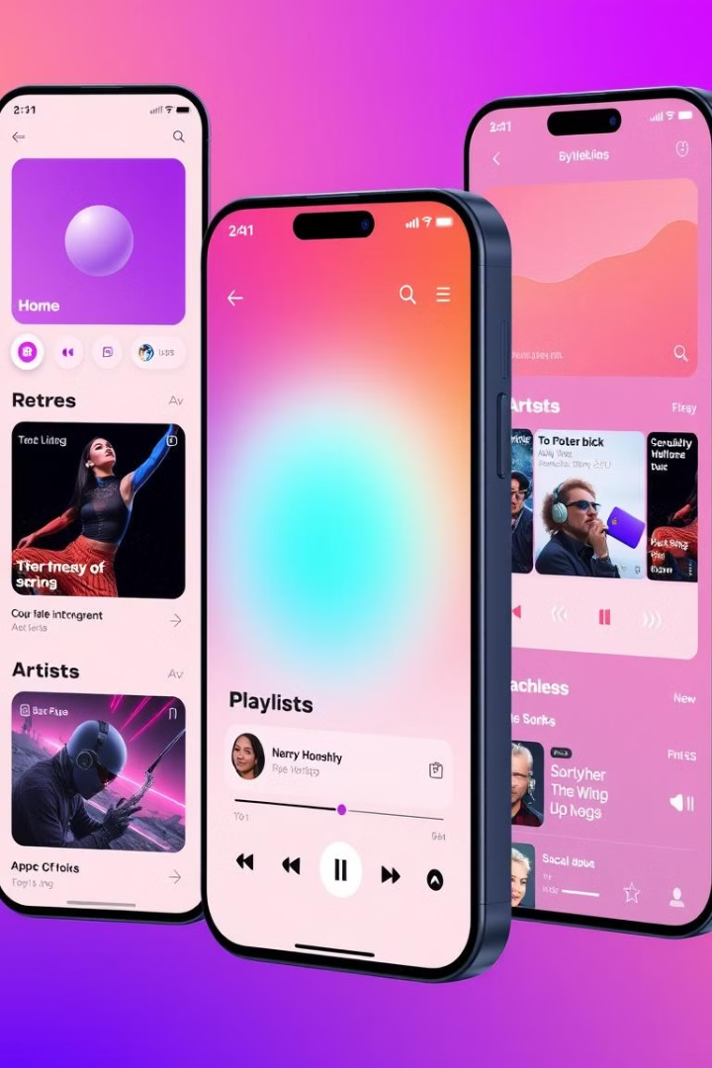




Explore SonicFusion's Features
SonicFusion simplifies music interactions. Discover, play, and manage your music effortlessly.
Home
Featured
Retro
Artists

Slide 4

Key Objectives of SonicFusion
Our mission is to deliver a seamless, personalized experience. Security and efficient database management are paramount.
1
Personalized Experience
2
Seamless Streaming
3
User Security
Curated playlists based on user taste.
Uninterrupted music playback.
Secure access to personal data.

Slide 5

Unlocking the Benefits of SonicFusion
SonicFusion enhances user experience and offers secure, real-time updates. Enjoy AI-powered recommendations and future scalability.
Enhanced Experience
Automated Recommendations
Secure Data

Slide 6
Core Software Components
SonicFusion is built on modern technologies. It ensures peak performance and scalability.
Front-End
Back-End
Database
HTML, CSS, JavaScript (React.js)
PHP
MongoDB / MySQL

Slide 7
Essential Hardware Specifications
Robust hardware ensures optimal performance. Meet the requirements for seamless streaming.
Processor
1
Intel i3 or higher
RAM
2
4GB or more
Storage
3
50GB Hard Disk

Slide 8

References
Expand your knowledge with these key resources. Enhance your understanding of front-end, back-end, and database development.
w3schools.com
Front-end and database tutorials
tutorialspoint.com
Backend development concepts
stackoverflow.com
Community troubleshooting

Slide 9

Thank You
Thank you for your time. We hope you enjoyed the presentation.

